Slide 1



Data Science and Machine Learning
Generative AI II

Slide 2
Generative AI & Large Language Models II

Slide 3
Prompting and prompt engineering

Slide 4

Prompting and prompt engineering
Prompt
Model
Completion
Where is Ganymede located in the solar system?
Where is Ganymede located in the solar system?
Ganymede is a moon of Jupiter and is located in the solar system within Jupiter’s orbit.
LLM
Context window: typically a few thousand words

Slide 5


In-context learning (ICL) - zero shot inference
Prompt
Model
Completion
Classify this review: I loved this movie!
Sentiment:
Classify this review: I loved this movie!
Sentiment: Positive
LLM
Zero-shot inference

Slide 6
In-context learning (ICL) - zero shot inference
Prompt
Model
Completion
Classify this review: I loved this movie!
Sentiment:
Classify this review: I loved this movie!
Sentiment: eived a very nice book review
LLM

Slide 7
In-context learning (ICL) - one shot inference
Prompt
Model
Completion
Classify this review: I loved this movie!
Sentiment: Positive
Classify this review: I loved this movie!
Sentiment: Positive
Classify this review: I don’t like this chair.
Sentiment: Negative
LLM
Classify this review: I don’t like this chair.
Sentiment:
One-shot inference

Slide 8
In-context learning (ICL) - few shot inference
Prompt
Model
Completion
Classify this review: I loved this DVD!
Sentiment: Positive
Classify this review: I loved this DVD!
Sentiment: Positive
Classify this review: I don’t like this chair.
Sentiment: Positive
Classify this review: This is not great.
Sentiment: Negative
LLM
Classify this review: I don’t like this chair.
Sentiment: Negative
Classify this review: This is not great.
Sentiment:

Slide 9




Summary of in-context learning (ICL)
Prompt // Zero Shot
Prompt // One Shot
Prompt // Few Shot
>5 or 6 examples
Classify this review: I loved this movie!
Sentiment:
Classify this review: I loved this movie!
Sentiment: Positive
Classify this review: I don’t like this chair.
Sentiment:
Classify this review: I loved this movie!
Sentiment: Positive
Classify this review: I don’t like this chair.
Sentiment: Negative
Classify this review: Who would use this product?
Sentiment:
Context Window
(few thousand words)

Slide 10
Helping LLMs reason and plan with Chain-of-Thought Prompting

Slide 11

LLMs can struggle with complex reasoning problems
Prompt
Model
Completion
Q: Roger has 5 tennis balls. He buys 2 more cans of tennis balls. Each can has 3 tennis balls. How many tennis balls does he have now?
Q: Roger has 5 tennis balls. He buys 2 more cans of tennis balls. Each can has 3 tennis balls. How many tennis balls does he have now?
LLM
A: The answer is 11
A: The answer is 11
Q: The cafeteria had 23 apples. If they used 20 to make lunch and bought 6 more, how many apples do they have?
Q: The cafeteria had 23 apples. If they used 20 to make lunch and bought 6 more, how many apples do they have?
A: The answer is 27.

Slide 12



Humans take a step-by-step approach to solving complex problems
Roger has 5 tennis balls. He buys 2 more cans of tennis balls. Each can has 3 tennis balls. How many tennis balls does he have now?
Start: Roger started with 5 balls.
Step 1: 2 cans of 3 tennis balls each is 6 tennis balls.
Step 1: 2 cans of 3 tennis balls each is 6 tennis balls.
Step 2: 5 + 6 = 11
Step 2: 5 + 6 = 11
End: The answer is 11
Reasoning steps
“Chain of thought”

Slide 13
Chain-of-Thought Prompting can help LLMs reason
Prompt
Model
Completion
Q: Roger has 5 tennis balls. He buys 2 more cans of tennis balls. Each can has 3 tennis balls. How many tennis balls does he have now?
Q: Roger has 5 tennis balls.
...
...
...
how many apples do they have?
A: The cafeteria had 23 apples originally. They used
20 to make lunch. So they had 23-20 = 3. They bought 6 more apples, so they have 3 + 6 =
9. The answer is 9. ✔
LLM
A: Roger started with 5 balls. 2 cans of 3 tennis balls each is 6 tennis balls.
5 + 6 = 11.The answer is 11.
Q: The cafeteria had 23 apples. If they used 20 to make lunch and bought 6 more, how many apples do they have?
Source: Wei et al. 2022, “Chain-of-Thought Prompting Elicits Reasoning in Large Language Models”

Slide 14
Chain-of-Thought Prompting can help LLMs reason
Prompt
Model
Completion
Q: Yes or no: Would a pear sink in water?
Q: Yes or no: Would a pear sink in water?
...
...
So the answer is no.
The density of gold is 19.3 g/cm^3, which is much greater than the density of water.
Therefore, a gold ring would sink to the bottom of a swimming pool. So the answer is yes.
A: The density of a pear is about 0.6 g/cm^3, which is less than water. Thus, a pear would float. So the answer is no.
LLM
Q. Yes or no: Would a gold ring sink to the bottom of a swimming pool?
Source: Wei et al. 2022, “Chain-of-Thought Prompting Elicits Reasoning in Large Language Models”

Slide 15
Generative configuration parameters for inference

Slide 16
Generative configuration - inference parameters
Max new tokens
Enter your prompt here…
200
Sample top K
Sample top P
Temperature
25
1
Inference configuration parameters
0.8
Submit

Slide 17
Generative configuration - max new tokens
Max new tokens
Enter your prompt here…
200
Max new tokens
Sample top K
25
Sample top P
1
Temperature
0.8
Submit

Slide 18
Generative config - max new tokens
max_new_tokens = 100
max_new_tokens = 150
Softmax
output
max_new_tokens = 200

Slide 19

Generative config - max new tokens
max_new_tokens = 100
max_new_tokens = 150
Softmax
output
max_new_tokens = 200
Stop token

Slide 20

Generative config - greedy vs. random sampling
Token probability
0.20
cake
greedy: The word/token with the highest probability is selected.
0.10
donut
Softmax
output
0.02
banana
0.01
apple
…
…
prob
word
0.20
cake
random(-weighted) sampling: select a token using a random-weighted strategy across the probabilities of all tokens.
0.10
donut
Softmax
output
0.02
banana
Here, there is a 20% chance that ‘cake’ will be selected, but ‘banana’ was actually selected.
0.01
apple
…
…

Slide 21
Generative configuration - top-k and top-p
Enter your prompt here…
Max new tokens
200
Top-k and top-p sampling
Sample top K
Sample top P
25
1
Temperature
0.8
Submit

Slide 22



Generative config - top-k sampling
prob
word
0.20
cake
top-k: select an output from the top-k results after applying random-weighted strategy using the probabilities
0.10
donut
Softmax
output
0.02
banana
k=3
0.01
apple
…
…

Slide 23

Generative config - top-p sampling
prob
word
0.20
cake
top-p: select an output using the random-weighted strategy with the top-ranked consecutive results by probability and with a cumulative probability <= p.
p = 0.30
0.10
donut
Softmax
output
banana
0.02
0.01
apple
…
…

Slide 24
Generative configuration - temperature
Enter your prompt here…
Max new tokens
200
Sample top K
25
Sample top P
1
Temperature
0.8
Temperature
Submit

Slide 25





Generative config - temperature
Temperature setting
Cooler temperature (e.g <1)
prob word
Higher temperature (>1)
prob word
0.001 | apple
0.002 | banana
0.400 | cake
0.012 | donut
… | …
0.040 | apple
0.080 | banana
0.150 | cake
0.120 | donut
… | …
Softmax
output
Strongly peaked probability distribution
Broader, flatter probability distribution

Slide 26
Retrieval augmented generation (RAG)

Slide 27

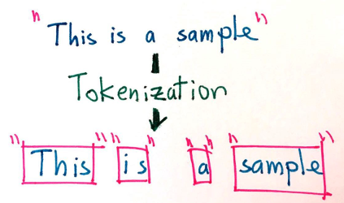
Embeddings
From words to numbers
Tokenization is the act of splitting strings into lists of “tokens” (not words, but very close)

Slide 28
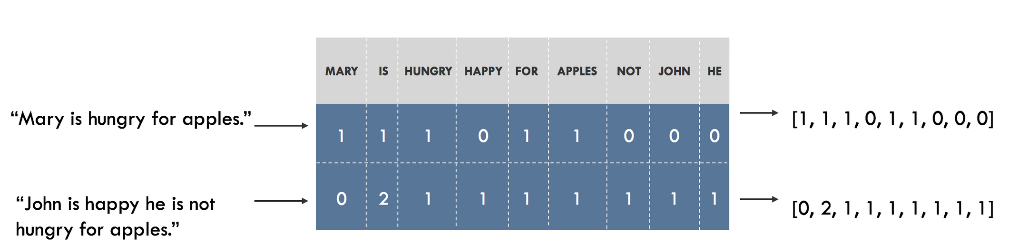
Embeddings
From words to numbers

Slide 29
Embeddings
From words to numbers
What if we could represent the words via its “meaning” and not its letters?
Using only “letters”
User query: “Someone in my class had a question!
No Match
Student
Lab
Exercise

Slide 30
Using Semantic Similarity
Embeddings
From words to numbers
Dashboard
Cockpit
Training data:
FROM DOCUMENTATION
Cockpit Portfolio dashboard, leveraging data from C1st and C3, tracks revenues and CVC for pilots and contributors.
Client Cockpit uses C1st and C3 databases to highlight revenues and CVC metrics.
In Cockpit Portfolio, C1st and C3 data inform revenues and CVC for pilots and contributors.
Client Cockpit shows revenues and CVC, using C1st and C3 data sources.
Cockpit Portfolio dashboard integrates C1st and C3 data for revenues and CVC insights.
Client Cockpit leverages C1st and C3 to display revenues and CVC metrics.
Cockpit Portfolio uses C1st and C3 databases to analyze revenues and CVC for pilots and contributors.
….
Client Cockpit leverages data from C1st and C3 to present revenues and CVC.
Cockpit Portfolio provides revenues and CVC insights using C1st and C3 data.
Client Cockpit extracts revenues and CVC metrics from C1st and C3.
Cockpit Portfolio dashboard highlights revenues and CVC from C1st and C3.
Client Cockpit analyzes revenues and CVC using C1st and C3 databases.
Cockpit Portfolio leverages C1st and C3 to monitor revenues and CVC.
Client Cockpit displays revenues and CVC metrics, using data from C1st and C3.
FROM USERS’ EMAILS:
"Where is my dashboard? I think it is called Cockpit Portfolio, and it uses data from C1st and C3 to track revenues and CVC for pilots and contributors."
"Can I see revenues and CVC in the Client Cockpit using data from C1st and C3?"
"Is the Cockpit Portfolio dashboard integrating C1st and C3 data for revenues and CVC insights?"
"Does Client Cockpit show revenues and CVC metrics using C1st and C3 databases?"
"How does the Cockpit Portfolio leverage C1st and C3 data to analyze revenues and CVC for pilots and contributors?"and CVC from C1st and C3?"
"Is Client Cockpit analyzing revenues and CVC using C1st and C3 databases?"
"Does Cockpit Portfolio leverage C1st and C3 to monitor revenues and CVC?"
"Can Client Cockpit display revenues and CVC metrics using data from C1st and C3?"
C1st
Tableau
Pilot
Contributors
C3
Portfolio
Revenues
CVC
Client

Slide 31
Using Semantic Similarity
Embeddings
From words to numbers
Dashboard
Training data:
FROM DOCUMENTATION
Cockpit Portfolio dashboard, leveraging data from C1st and C3, tracks revenues and CVC for pilots and contributors.
Client Cockpit uses C1st and C3 databases to highlight revenues and CVC metrics.
In Cockpit Portfolio, C1st and C3 data inform revenues and CVC for pilots and contributors.
Client Cockpit shows revenues and CVC, using C1st and C3 data sources.
Cockpit Portfolio dashboard integrates C1st and C3 data for revenues and CVC insights.
Client Cockpit leverages C1st and C3 to display revenues and CVC metrics.
Cockpit Portfolio uses C1st and C3 databases to analyze revenues and CVC for pilots and contributors.
….
Client Cockpit leverages data from C1st and C3 to present revenues and CVC.
Cockpit Portfolio provides revenues and CVC insights using C1st and C3 data.
Client Cockpit extracts revenues and CVC metrics from C1st and C3.
Cockpit Portfolio dashboard highlights revenues and CVC from C1st and C3.
Client Cockpit analyzes revenues and CVC using C1st and C3 databases.
Cockpit Portfolio leverages C1st and C3 to monitor revenues and CVC.
Client Cockpit displays revenues and CVC metrics, using data from C1st and C3.
FROM USERS’ EMAILS:
"Where is my dashboard? I think it is called Cockpit Portfolio, and it uses data from C1st and C3 to track revenues and CVC for pilots and contributors."
"Can I see revenues and CVC in the Client Cockpit using data from C1st and C3?"
"Is the Cockpit Portfolio dashboard integrating C1st and C3 data for revenues and CVC insights?"
"Does Client Cockpit show revenues and CVC metrics using C1st and C3 databases?"
"How does the Cockpit Portfolio leverage C1st and C3 data to analyze revenues and CVC for pilots and contributors?"and CVC from C1st and C3?"
"Is Client Cockpit analyzing revenues and CVC using C1st and C3 databases?"
"Does Cockpit Portfolio leverage C1st and C3 to monitor revenues and CVC?"
"Can Client Cockpit display revenues and CVC metrics using data from C1st and C3?"
C1st
Tableau
Pilot
Contributors
C3
Revenues
CVC
Client
Cockpit
Portfolio

Slide 32
Using Semantic Similarity
Embeddings
From words to numbers
Dashboard
Training data:
FROM DOCUMENTATION
Cockpit Portfolio dashboard, leveraging data from C1st and C3, tracks revenues and CVC for pilots and contributors.
Client Cockpit uses C1st and C3 databases to highlight revenues and CVC metrics.
In Cockpit Portfolio, C1st and C3 data inform revenues and CVC for pilots and contributors.
Client Cockpit shows revenues and CVC, using C1st and C3 data sources.
Cockpit Portfolio dashboard integrates C1st and C3 data for revenues and CVC insights.
Client Cockpit leverages C1st and C3 to display revenues and CVC metrics.
Cockpit Portfolio uses C1st and C3 databases to analyze revenues and CVC for pilots and contributors.
….
Client Cockpit leverages data from C1st and C3 to present revenues and CVC.
Cockpit Portfolio provides revenues and CVC insights using C1st and C3 data.
Client Cockpit extracts revenues and CVC metrics from C1st and C3.
Cockpit Portfolio dashboard highlights revenues and CVC from C1st and C3.
Client Cockpit analyzes revenues and CVC using C1st and C3 databases.
Cockpit Portfolio leverages C1st and C3 to monitor revenues and CVC.
Client Cockpit displays revenues and CVC metrics, using data from C1st and C3.
FROM USERS’ EMAILS:
"Where is my dashboard? I think it is called Cockpit Portfolio, and it uses data from C1st and C3 to track revenues and CVC for pilots and contributors."
"Can I see revenues and CVC in the Client Cockpit using data from C1st and C3?"
"Is the Cockpit Portfolio dashboard integrating C1st and C3 data for revenues and CVC insights?"
"Does Client Cockpit show revenues and CVC metrics using C1st and C3 databases?"
"How does the Cockpit Portfolio leverage C1st and C3 data to analyze revenues and CVC for pilots and contributors?"and CVC from C1st and C3?"
"Is Client Cockpit analyzing revenues and CVC using C1st and C3 databases?"
"Does Cockpit Portfolio leverage C1st and C3 to monitor revenues and CVC?"
"Can Client Cockpit display revenues and CVC metrics using data from C1st and C3?"
C1st
Tableau
Pilot
Contributors
C3
Revenues
CVC
Client
Cockpit
Portfolio

Slide 33
Using Semantic Similarity
Embeddings
From words to numbers
Training data:
FROM DOCUMENTATION
Cockpit Portfolio dashboard, leveraging data from C1st and C3, tracks revenues and CVC for pilots and contributors.
Client Cockpit uses C1st and C3 databases to highlight revenues and CVC metrics.
In Cockpit Portfolio, C1st and C3 data inform revenues and CVC for pilots and contributors.
Client Cockpit shows revenues and CVC, using C1st and C3 data sources.
Cockpit Portfolio dashboard integrates C1st and C3 data for revenues and CVC insights.
Client Cockpit leverages C1st and C3 to display revenues and CVC metrics.
Cockpit Portfolio uses C1st and C3 databases to analyze revenues and CVC for pilots and contributors.
….
Client Cockpit leverages data from C1st and C3 to present revenues and CVC.
Cockpit Portfolio provides revenues and CVC insights using C1st and C3 data.
Client Cockpit extracts revenues and CVC metrics from C1st and C3.
Cockpit Portfolio dashboard highlights revenues and CVC from C1st and C3.
Client Cockpit analyzes revenues and CVC using C1st and C3 databases.
Cockpit Portfolio leverages C1st and C3 to monitor revenues and CVC.
Client Cockpit displays revenues and CVC metrics, using data from C1st and C3.
FROM USERS’ EMAILS:
"Where is my dashboard? I think it is called Cockpit Portfolio, and it uses data from C1st and C3 to track revenues and CVC for pilots and contributors."
"Can I see revenues and CVC in the Client Cockpit using data from C1st and C3?"
"Is the Cockpit Portfolio dashboard integrating C1st and C3 data for revenues and CVC insights?"
"Does Client Cockpit show revenues and CVC metrics using C1st and C3 databases?"
"How does the Cockpit Portfolio leverage C1st and C3 data to analyze revenues and CVC for pilots and contributors?"and CVC from C1st and C3?"
"Is Client Cockpit analyzing revenues and CVC using C1st and C3 databases?"
"Does Cockpit Portfolio leverage C1st and C3 to monitor revenues and CVC?"
"Can Client Cockpit display revenues and CVC metrics using data from C1st and C3?"
Pilot
C1st
Contributors
C3
Revenues
CVC
Dashboard
Tableau
Client
Cockpit
Portfolio

Slide 34
Using Semantic Similarity
Embeddings
This is called an embedding vector
Pilot
C1st
Contributors
C3
Revenues
CVC
Dashboard
Tableau
Client
Cockpit
Portfolio

Slide 35
Using Semantic Similarity
Embeddings
All this to…
User query: “Can you tell me where my dashboard with my MNCs is?
Pilot
C1st
Atlas 2
MNCs
Contributors
Capital
C3
Revenues
CVC
Can you tell me where my dashboard with my MNCs is?
Deposits
Docname; source
Docname;source
Docname;source
Docname;source
Docname;source
Docname;source
Link
Dashboard
Tableau
PowerBI
Client
Cockpit
Portfolio

Slide 36
Using Semantic Similarity
Embeddings
Now imagine this on datasource metadata
Atlas2 field about the Product3 of C3 that the clients has bough
Field description
Field description
Field description
Field description
C1st
Field description
Atlas 2
Field description
Field description
Field description
Field description
Field description
Field description
Field description
Field description
Atlas2 field about the Product3 of C3 that the clients has bough
Top15 most related fields:
Fieldname; datasource
Fieldname; datasource
Fieldname; datasource
Fieldname; datasource
…
Fieldname; datasource
Fieldname; datasource
Field description
Field description
C3
Field description
Field description
Field description
Field description
Field description

Slide 37
Using Semantic Similarity
Embeddings
Now imagine this on datasource metadata
All fields that connect to RMPM
Field description
Field description
Field description
Field description
C1st
Field description
Atlas 2
Field description
Field description
Field description
Field description
Field description
Field description
Field description
Field description
All fields that connect to RMPM
Top15 most related fields:
Fieldname; datasource
Fieldname; datasource
Fieldname; datasource
Fieldname; datasource
…
Fieldname; datasource
Fieldname; datasource
Field description
Field description
C3
Field description
Field description
Field description
Field description
Field description

Slide 38
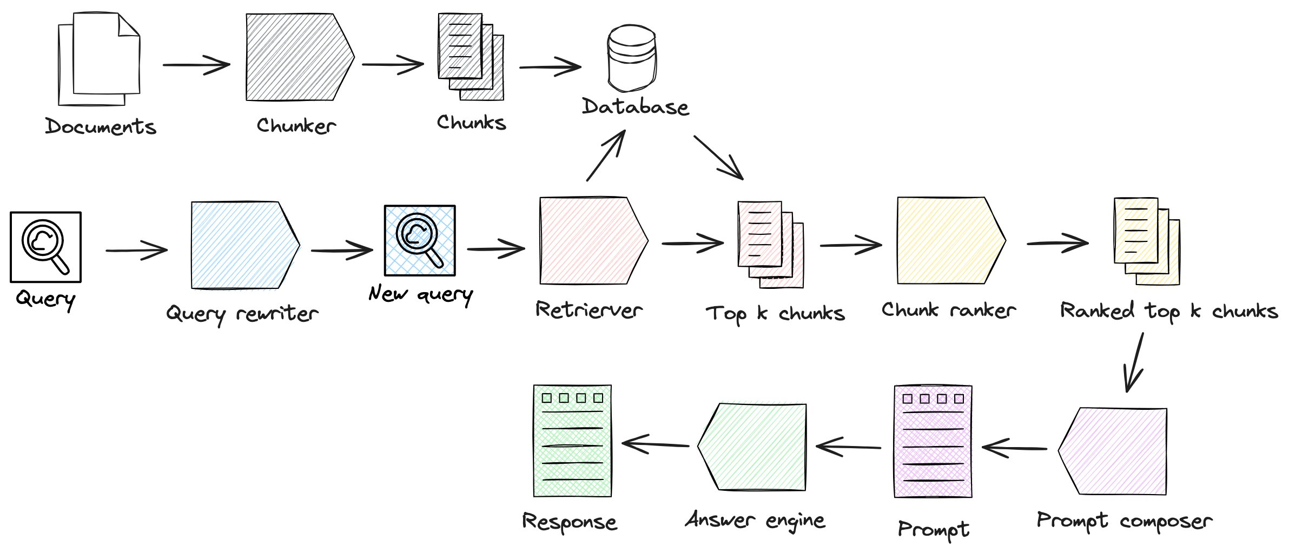
RAG (Retreived Augmented Generation) Bring it all together
Retreiver step
Generation step

Slide 39
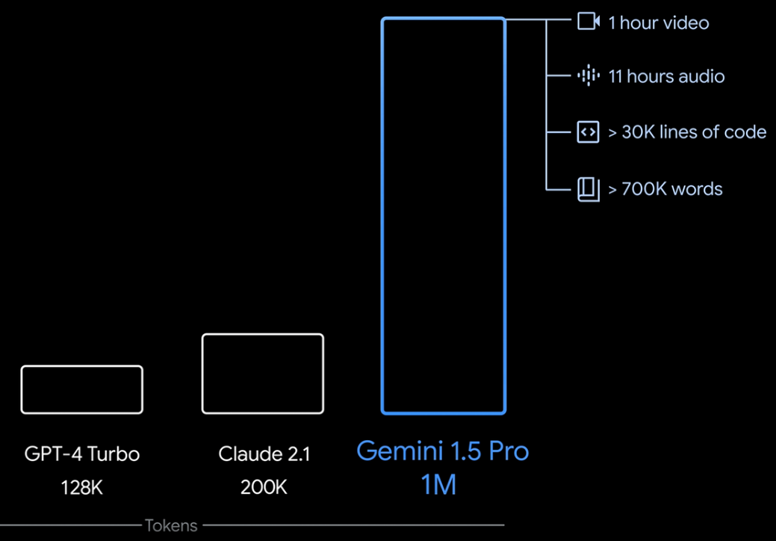
RAG

Slide 40
Knowledge cut-offs in LLMs
Prompt
Model
Completion
Who is the current Prime Minister of the United Kingdom?
Who is the current Prime Minister of the United Kingdom?
Boris Johnson
LLM

Slide 41









LLM-powered applications
LLM
External Data Sources
User Application
Orchestration library
Documents
Database Web
External Applications

Slide 42




Retrieval Augmented Generation (RAG)
External information sources
Query encoder
LLM
Retriever
Lewis et al. 2020 “Retrieval-Augmented Generation for Knowledge-Intensive NLP Tasks”

Slide 43



Example: Searching legal documents
Input query
UNITED STATES DISTRICT COURT SOUTHERN DISTRICT OF MAINE
CASE NUMBER: 22-48710BI-SME
Busy Industries (Plaintiff) vs.
State of Maine (Defendant)
UNITED STATES DISTRICT COURT SOUTHERN DISTRICT OF MAINE
CASE NUMBER: 22-48710BI-SME
Busy Industries (Plaintiff) vs.
State of Maine (Defendant)
Who is the plaintiff in case 22-48710BI-SME?
Who is the plaintiff in case 22-48710BI-SME?
documents
Query Encoder
External Information Sources

Slide 44

Example: Searching legal documents
UNITED STATES DISTRICT COURT SOUTHERN DISTRICT OF MAINE
CASE NUMBER: 22-48710BI-SME
Completion
Busy Industries (Plaintiff) vs.
State of Maine (Defendant)
Busy Industries
LLM
Who is the plaintiff in case 22-48710BI-SME?

Slide 45
RAG integrates with many types of data sources
External Information Sources
Documents
Wikis
Expert Systems
Web pages
Databases
External information sources
Query encoder
Vector Store
Retriever

Slide 46

Data preparation for vector store for RAG
Two considerations for using external data in RAG:
1. Data must fit inside context window
Prompt context limit few 1000 tokens
Single document too large to fit in window
Split long sources into short chunks

Slide 47
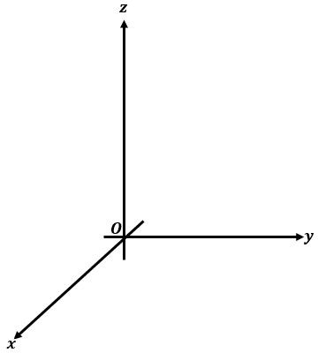




Data preparation for RAG
Two considerations for using external data in RAG:
Data must fit inside context window
Data must be in format that allows its relevance to be assessed at inference time: Embedding vectors
fire
Prompt text converted to embedding vectors
book
jumps
X₁
X₂
X₃
X₄
X₅
fox
swim
whale
Cosine similarity

Slide 48

Data preparation for RAG
Two considerations for using external data in RAG:
Data must fit inside context window
Data must be in format that allows its relevance to be assessed at inference time: Embedding vectors
Process each chunk with LLM to produce embedding vectors
X₁
X₂
X₃
X₄
X₅
X₆
X₁
X₂
X₃
X₄
X₁
X₂
X₃
X₄
X₅
X₁
X₂
X₃
X₄
X₅
X₆
X₇

Slide 49


Vector database search
Text 1
Each text in vector store is identified by a key
Enables a citation to be included in completion
Text 5
Text 2
Prompt
Text 4
Text 6
Text 3

Slide 50
RAG (Retreived Augmented Generation) Bring it all together

Slide 51
RAG (Retreived Augmented Generation) Bring it all together
Retreiver step
Generation step

Slide 52
RAG (Retreived Augmented Generation) Bring it all together
prompt = f"""
## INTRODUCTION
You are a Chatbot designed to help answer technical questions about the software at BNPP.
The user asked: "{user_question}"
## CONTEXT
Technical Documentation for the software:
'''
{_get_document_prompt(docs)}
'''
## RESTRICTIONS
Refer to the products by their names.
Be clear, transparent, and factual: only state what is in the context without providing opinions or subjectivity.
Answer the question based solely on the context above; if you do not know the answer, be clear with the user that you do not know.
Only respond to questions related to the products, avoiding jokes, offensive remarks, and discussions on religion or sexuality.
If the user does not provide sufficient context, do not answer and instead ask for more information on what the user wants to know.
## TASK
First, answer directly to the user, if possible
Second, point the user int he right direction of the documentation
## RESPONSE STRUCTURE:
'''
[answer text]]
Source:
• From pages [...] of the Technical Documentation for *Product1* (link)
• From pages [...] of the Technical Documentation for *Product2* (link)
'''
## CONVERSATION:
User: {user_question}
Agent:
"""

Slide 53
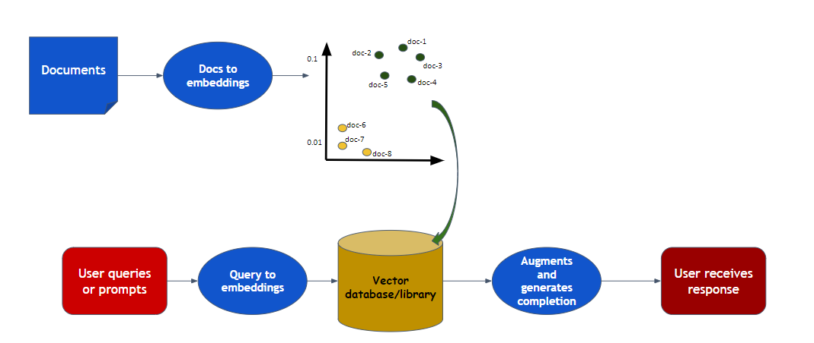
RAG (Retreived Augmented Generation) Bring it all together

Slide 54
Lets code this out?

